Slide 1
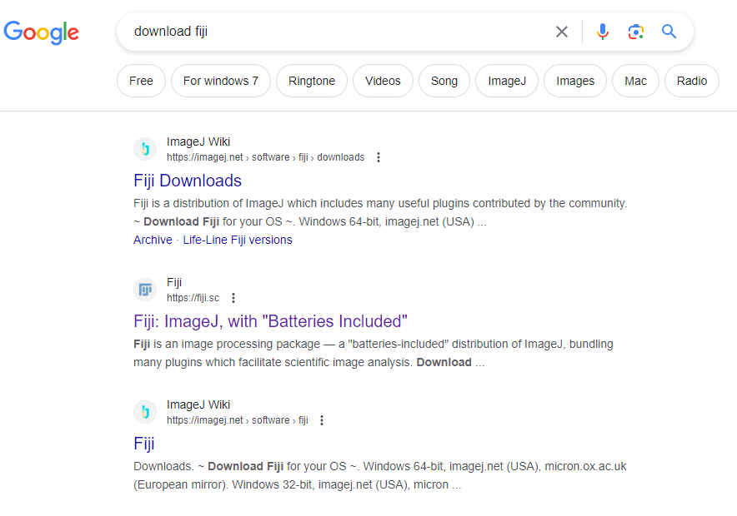
Download Fiji

Slide 2
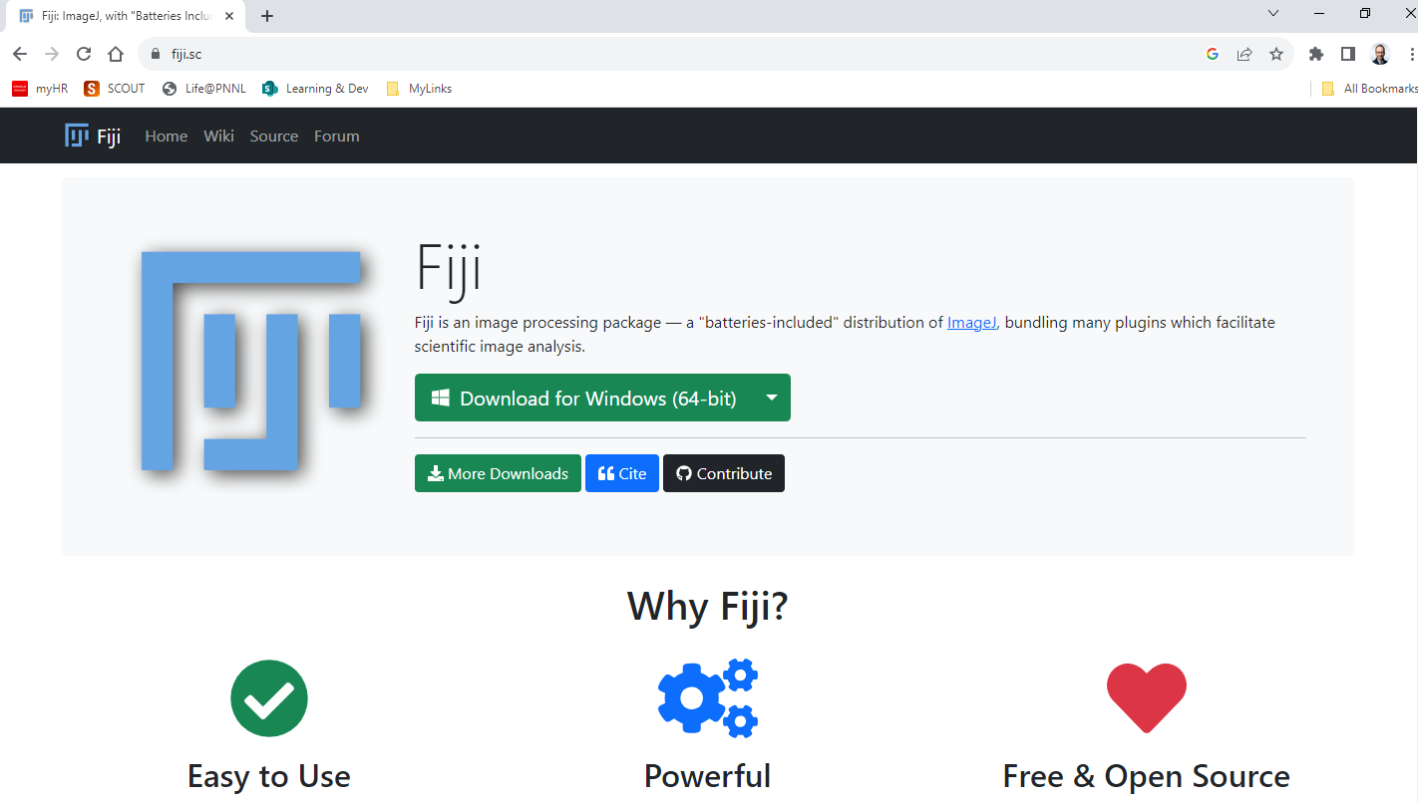
Install Fiji

Slide 3
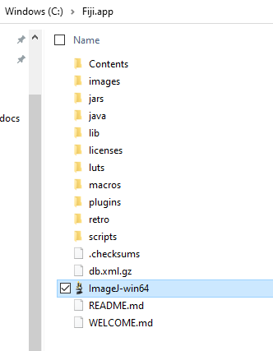
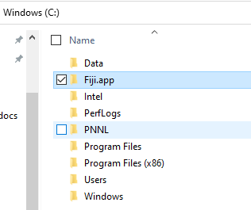
Install Fiji – cont.
Copy Fiji.app folder from zip file to C drive
Run application file “ImageJ-win64”
Allow for Java installation as offered (if you do not already run Java 1.8)
Once app started, run updater
You can pin this application file to taskbar for easy access

Slide 4
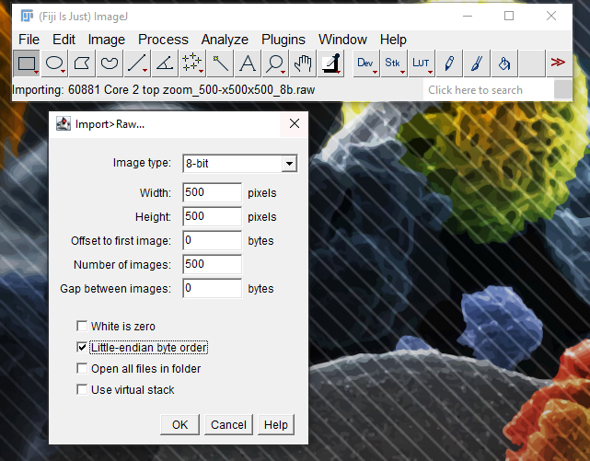
Import data: Soil core 2 top zoom_500x500x500_8b.raw

Slide 5
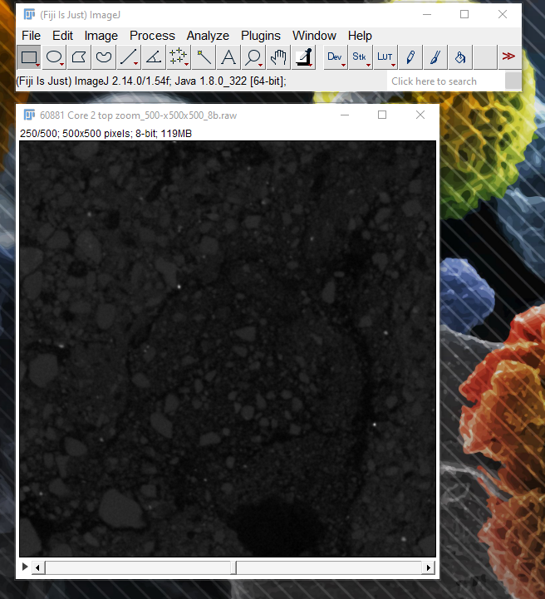
Import data – cont.

Slide 6
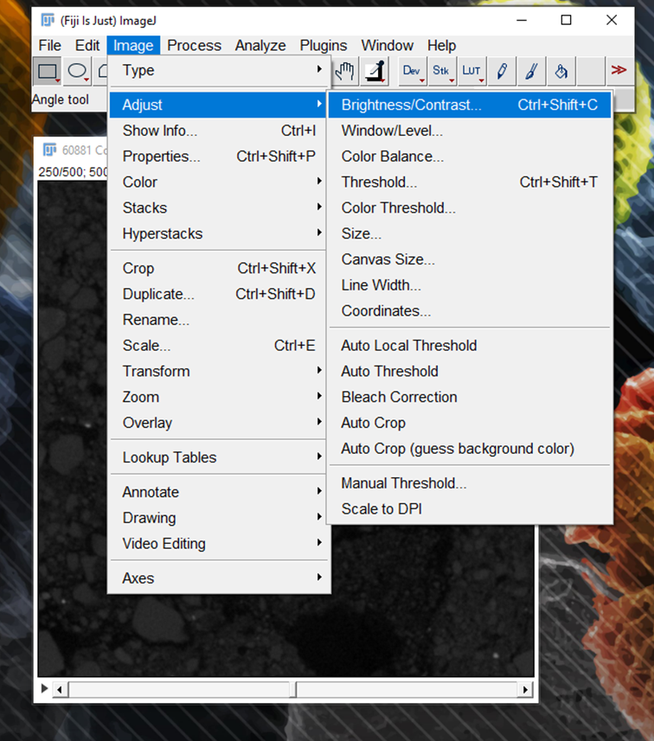
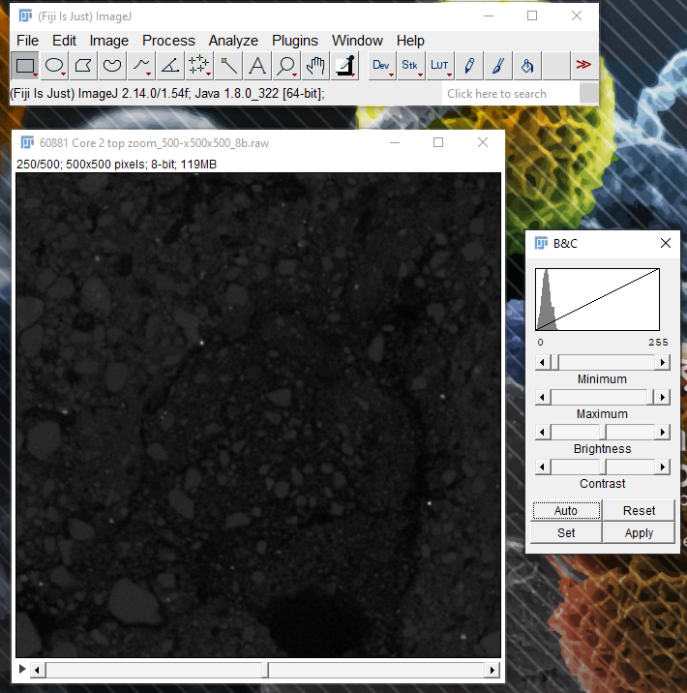
Enhance image contrast

Slide 7
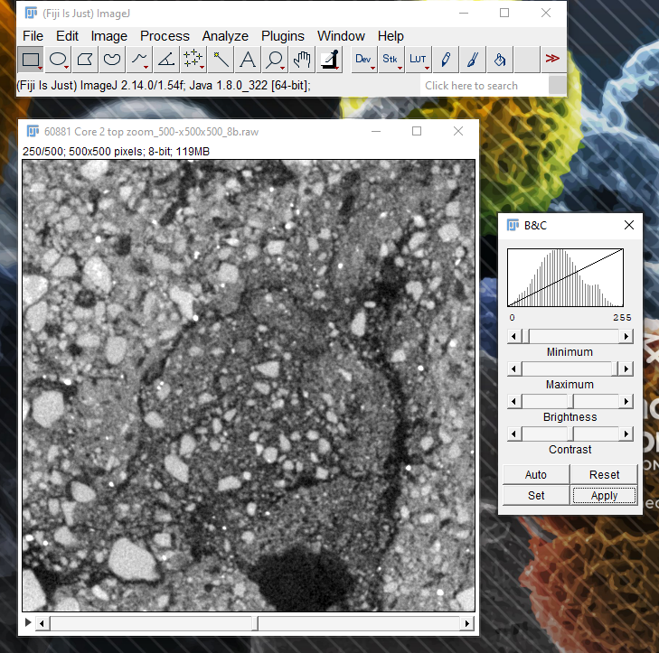
Enhance image contrast – cont.

Slide 8
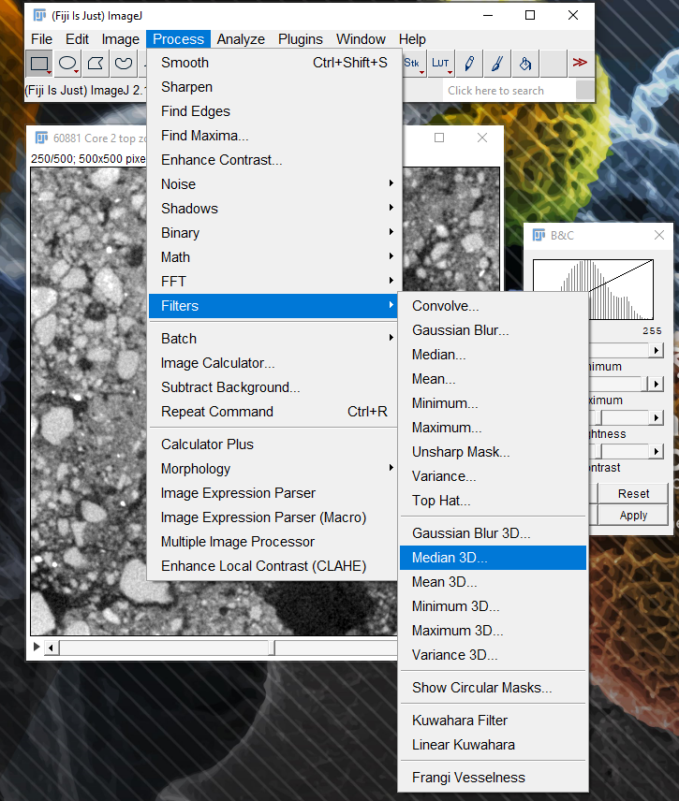
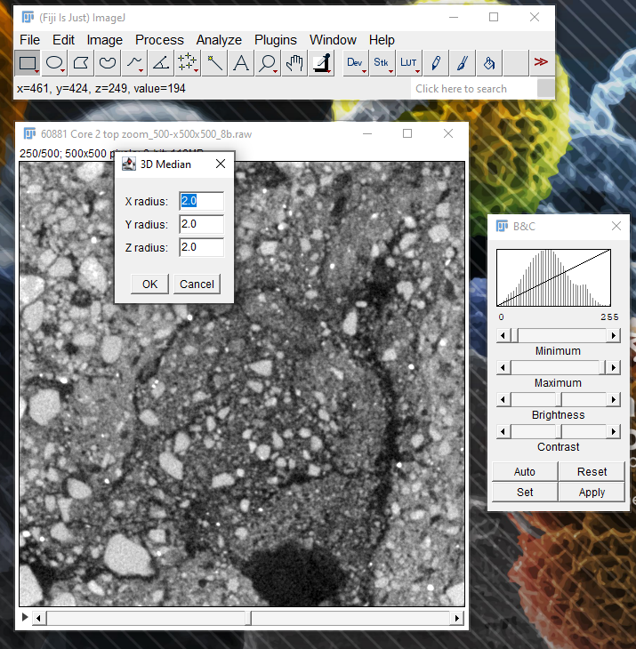
Filtering

Slide 9
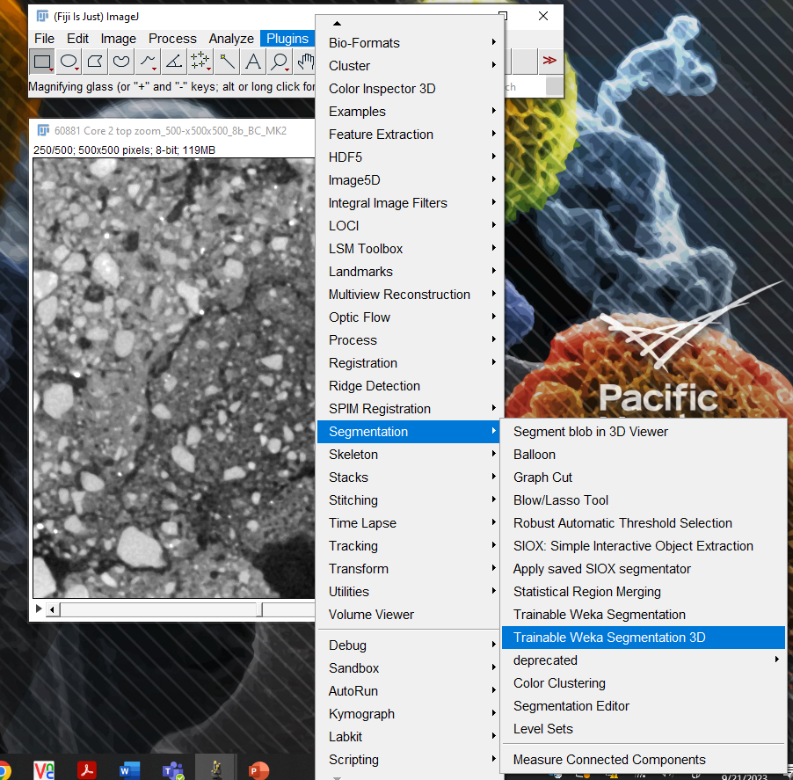
Segmentation – Trainable Weka Segmentation 3D plugin

Slide 10
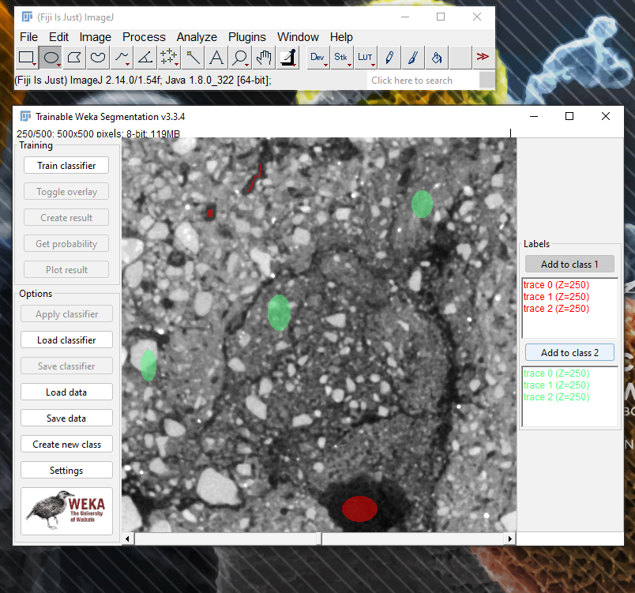
Segmentation – Annotate regions for pores (red) and soil matrix (green)

Slide 11
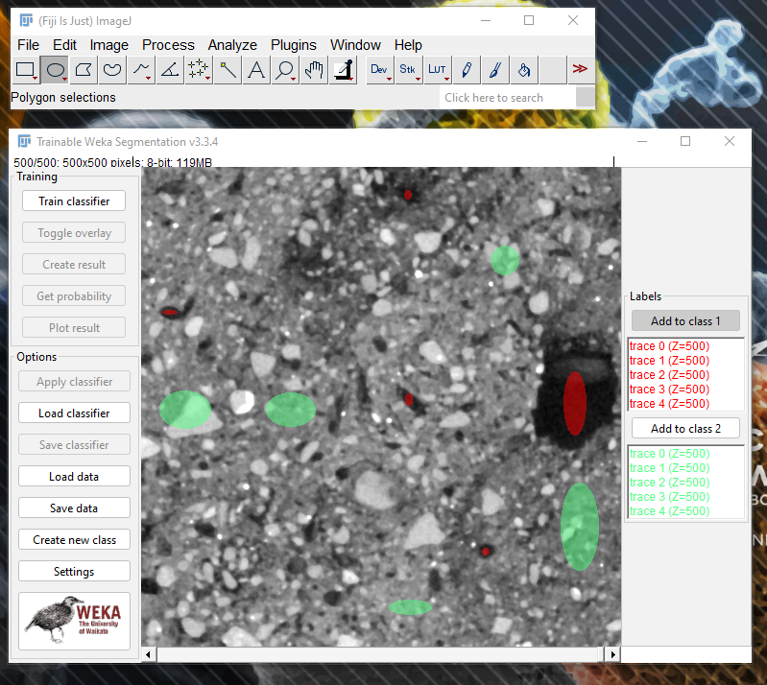
Segmentation – Do this classification for multiple slices (to create more training data)

Slide 12
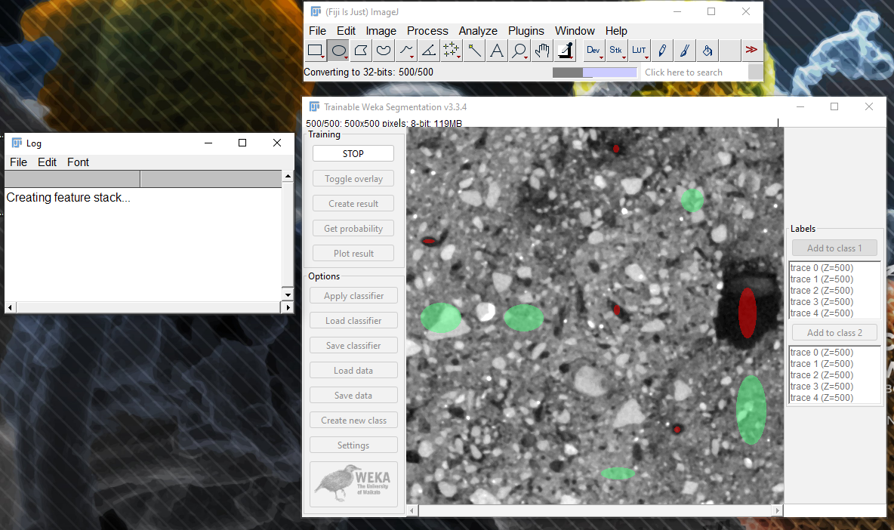
Segmentation – Train classifier (may take up to 30+ minutes)

Slide 13
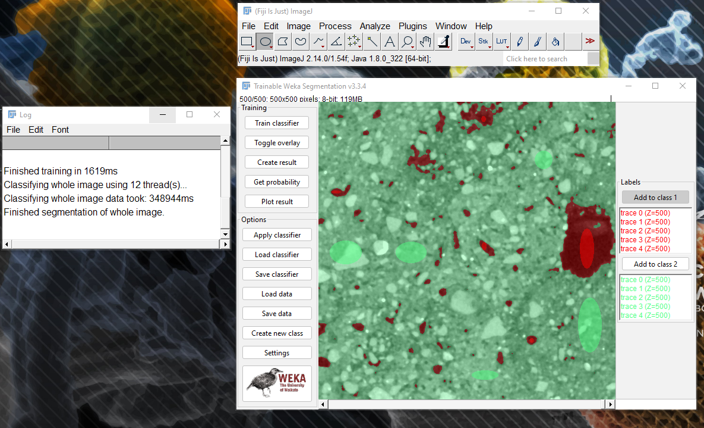
Segmentation – Create result from classified data

Slide 14
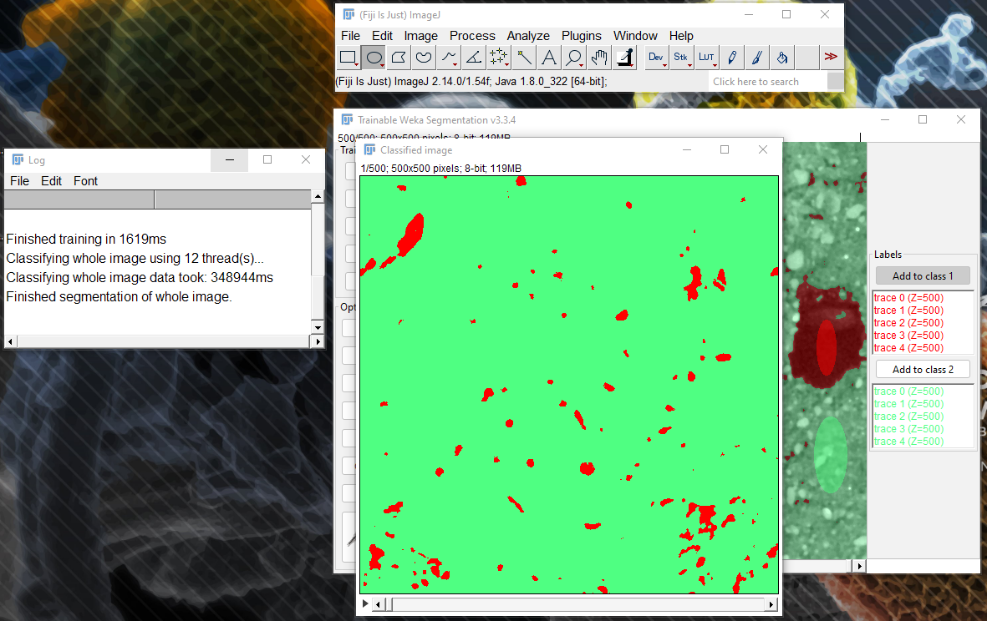
Segmentation – Create result from classified data – cont.

Slide 15
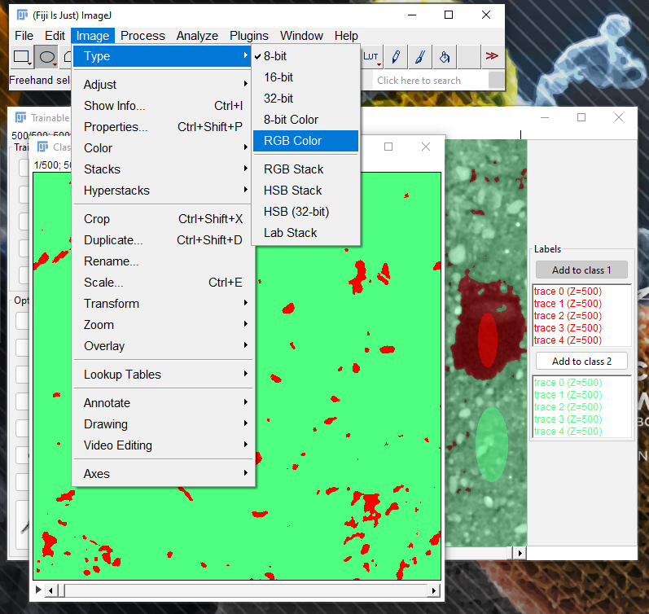
Segmentation – Convert segmentation result into RGB color data

Slide 16
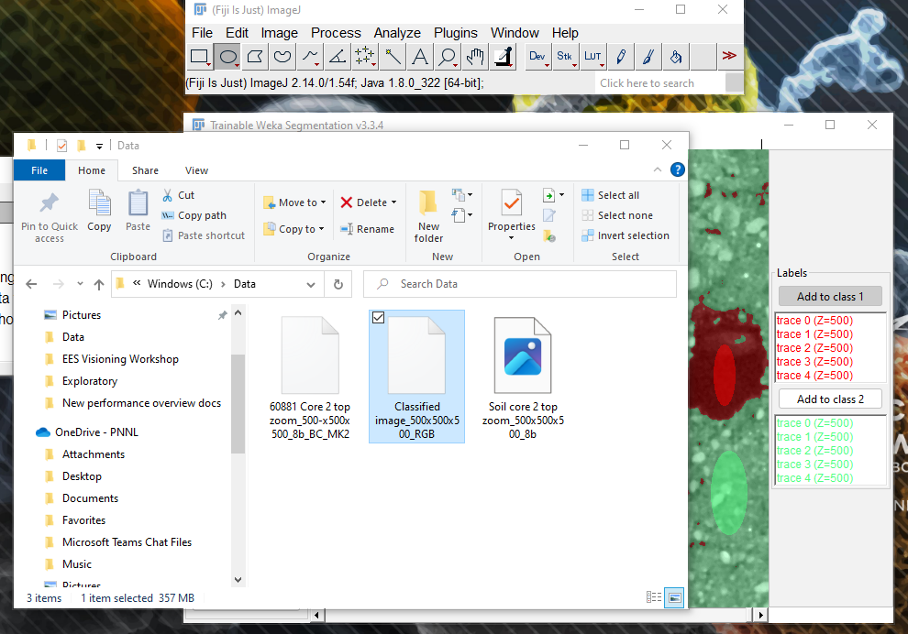
Segmentation – Save RGB color data as new raw file

Slide 17
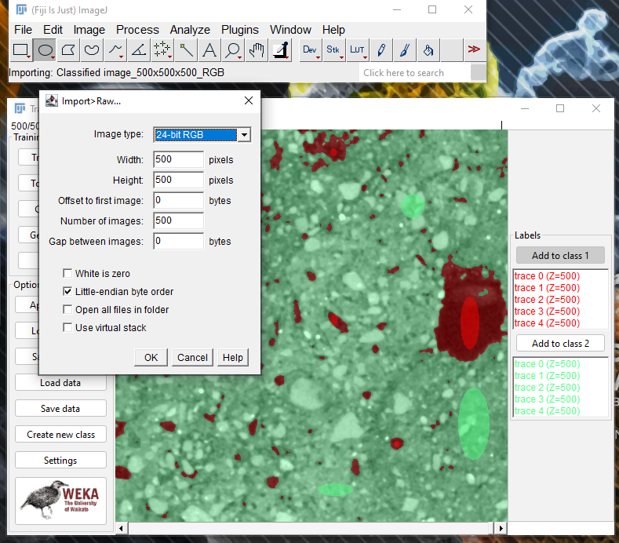
Segmentation – Open segmented (RGB) data as 24-bit RGB
File-Import-Raw-Select 24-bit RGB

Slide 18
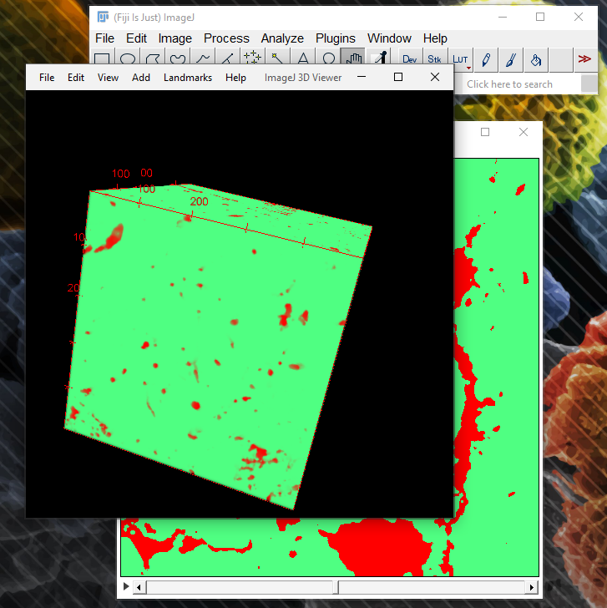
Visualization – The RGB data is not very useful for porosity visualization

Slide 19
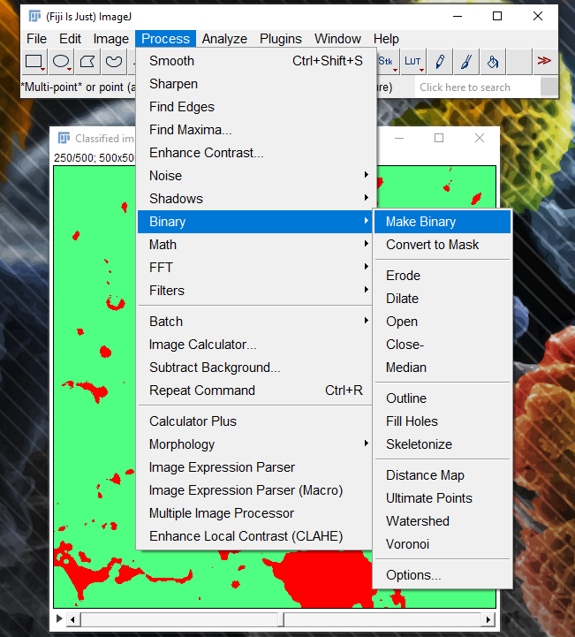
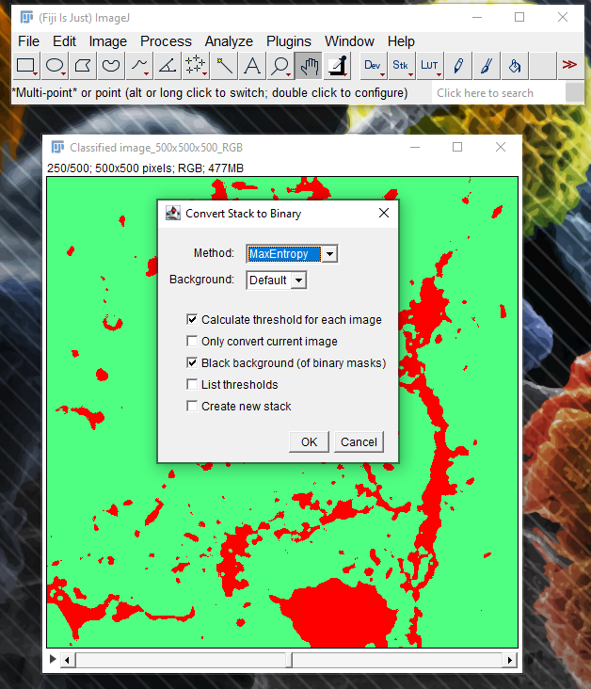
Visualization – Convert the RGB data into binary

Slide 20
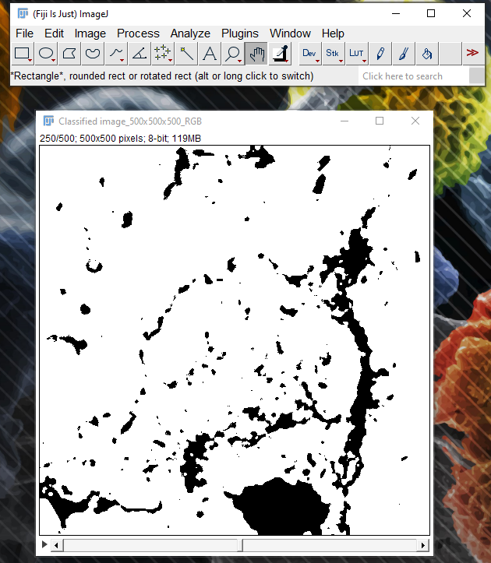
Visualization – Binarized data needs to be inverted (pores must be white)

Slide 21
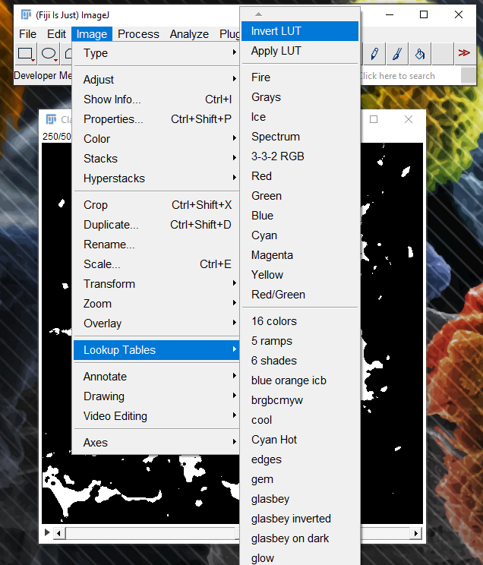
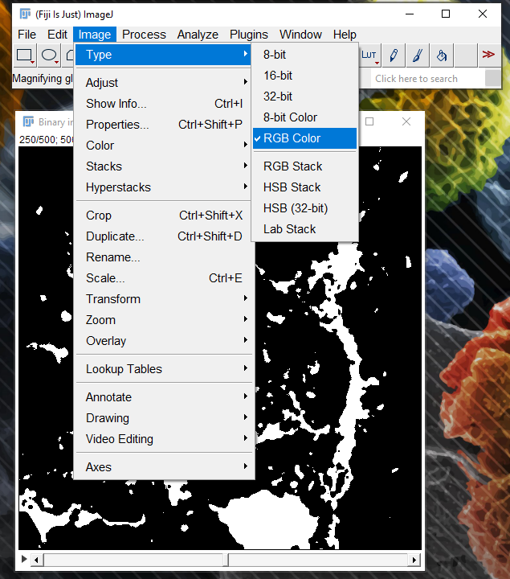
Visualization – Binarized data needs to be inverted (pores must be white)
Binarized data becomes 8-bit. It needs to be converted back to RGB so that it can be saved as inverted. The saved file can be opened again as 24-bit RGB.

Slide 22
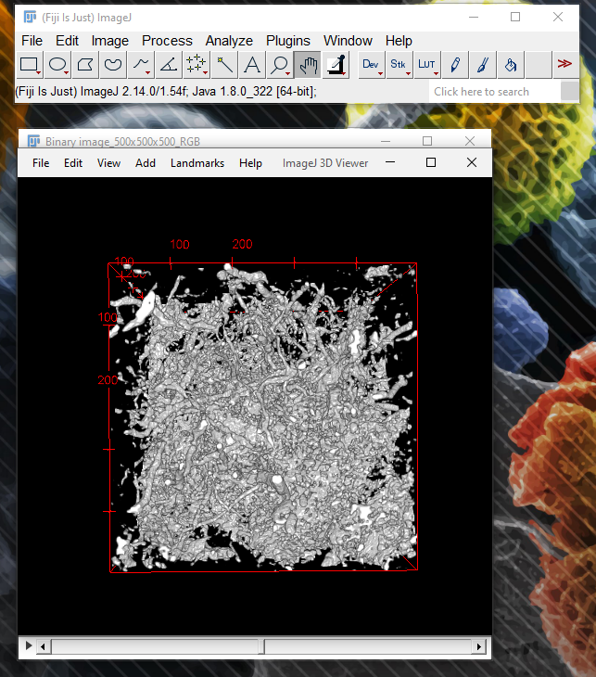
Visualization – Open 3D Viewer from Plugins to visualize the pore structure

Slide 23
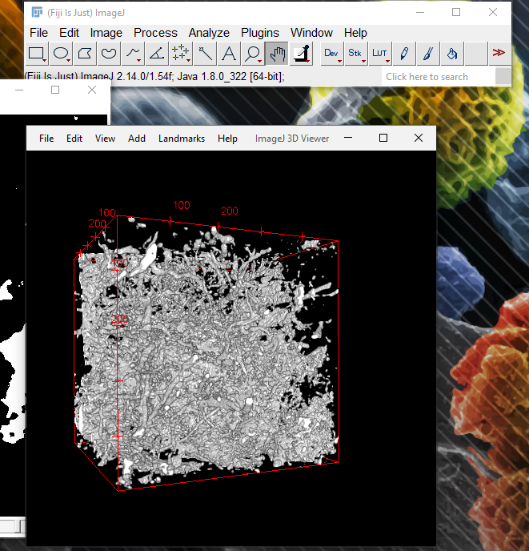
Visualization – Create an animation
- Click “Start animation” under “View”
- You can record a movie by clicking on “Record 360 deg rotation”

Slide 24
Using the porosity data: measurements, modeling
Volume analysis tools for pore network characterization
Conversion to STL format for visualization and modeling
…

